Slide 1
Breast Cancer Screening
Beyond 70 Years Old
Henry Kwok
Breast Imaging Fellow
BreastScreen Aotearoa Counties Manukau

Slide 2

Screening Beyond 70 Years Old
Pertinent Questions:
  Why bother?
  Is it effective?
  Is it worthwhile?

Slide 3
Why Bother?
1 in 5 breast cancer patients are >= 70 years of age
  Auckland Breast Cancer Registry Data
Currently BreastScreen Aotearoa is offering nationwide, publicly-funded breast cancer screening for all women aged 45-69.
  Some women >= 70 continue with screening if they meet certain risk criteria or through self-funding
The evidence for breast cancer screening beyond age 70 is lacking

Slide 4

Defining the Problem…
What do we know about breast cancers in patients aged 70 or over?

Slide 5
Auckland Breast Cancer Registry
Auckland Breast Cancer Registry captures all breast cancer cases in the Greater Auckland region since 2000
The Registry records de-identified data of patient demographics, cancer characteristics, treatment and long term follow up outcome

Slide 6
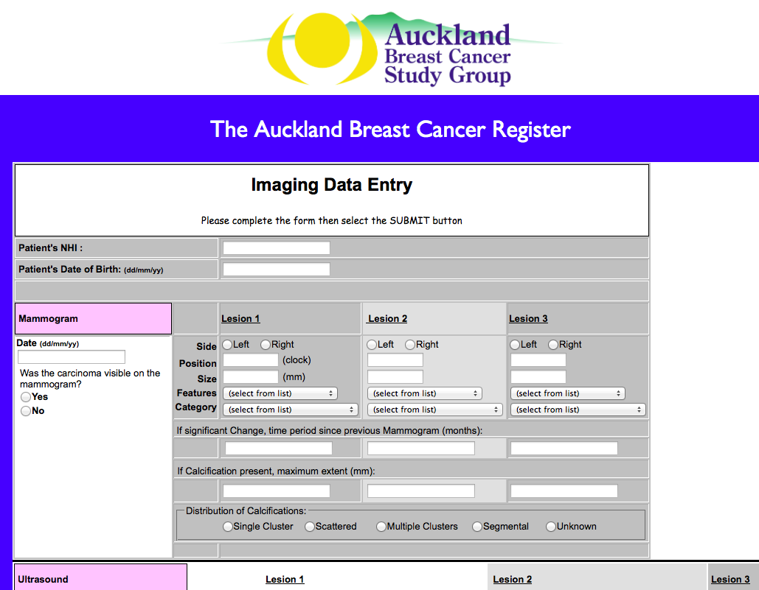

Slide 7
Study Objective #1
Using the Auckland Breast Cancer Registry Data, this study retrospectively examines:
  Demographics
  Mode of breast cancer presentation
    i.e. screen detected vs symptomatic
  Cancer characteristics at presentation
  Cancer stage at presentation
  Long term outcome
    Survival, recurrence, metastasis, second cancer
Ethics approval

Slide 8
Registry Data Set
The study covers the period 2000-2014
A total of 11481 patients have been identified
Of whom, 2002 (17%) of the patients were 70 or over

Slide 9
Patient Demographics
 | Overall | Under 70 | 70 or over
N | 11481 | 9479 | 2002
% total | 100% | 83% | 17%
Age | 58 | 53 | 79
% female | 99.4% | 99.6% | 98.5%
Ethnicity
European | 66% | 64% | 78%
Pacific | 8% | 8% | 5%
Maori | 7% | 8% | 3%
Asian | 7% | 8% | 3%

Slide 10
Breast Cancer Presentation

Slide 11
Breast Cancer Histology
 | Overall | Under 70 | 70 and over
IDC NOS | 68.1% | 68.1% | 67.9%
DCIS | 15.2% | 16.8% | 7.6%
Lobular | 9.7% | 8.9% | 13.8%
Tubular | 1.6% | 1.7% | 1.3%
Mucinous | 1.7% | 1.3% | 3.8%
Papillary | 0.4% | 0.3% | 1.0%
Medullary | 0.3% | 0.3% | 0.2%

Slide 12
T-Stage at Diagnosis

Slide 13
Nodal and Metastasis Status at Diagnosis
 | Overall | Under 70 | 70 or over
N stage
- N0 | 53% | 55% | 44%
- N1+N2+N3 | 31% | 31% | 29%
- Nx | 17% | 14% | 27%
M stage
- M0 | 13% | 14% | 7%
- M1 | 4% | 3% | 6%
- Mx | 84% | 83% | 87%

Slide 14
Nottingham Prognostic Index

Slide 15
Follow up - Outcome to-date
 | Under 70 | 70 or over
Recurrence | 5.3% | 4.2%
Second cancer | 3.0% | 2.1%
Metastasis | 13.0% | 15.3%
Death (all cause) | 12.8% | 41.9%
- Died of breast cancer | 9.1% | 14.8%
- Died with breast cancer | 1.4% | 3.2%
- Died of other causes | 2.3% | 23.8%

Slide 16
Predictors for Cancer Death:
Regression Analysis
Predictor | Odds ratio | P-value
Age >= 70 | 1.9 | P<0.05
Symptomatic | 4.1 | P<0.05
Positive node | 1.7 | P=0.07
Positive metastasis | 65 | P<0.05
ER positive | 0.55 | P<0.05
PR positive | 0.19 | P<0.05
NPI |  | P<0.05

Slide 17
Predictors for Recurrence:
Regression Analysis
Predictor | Odds Ratio | P-value
Age >= 70 | 0.31 | P<0.05
Symptomatic | 3.6 | P<0.05
Positive node | 0.63 | NS
Positive metastasis | 4.7 | P<0.05
ER positive | 0.28 | P<0.05
PR positive | 0.75 | NS
NPI |  | P<0.05

Slide 18
Defining the Problem…
In the >=70 age group, which make up 17% of the patient population, there are:
  More symptomatic presentation
  More invasive disease at more advanced stage; less in situ disease
  More cancer death, even adjusting for other prognosticators

Slide 19
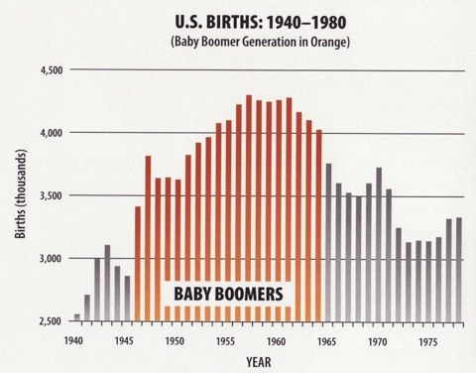
Baby Boomer

Slide 20

Finding a Solution…
Can screening reduce excess cancer-mortality in patients >= 70 years of age?
Little direct evidence

Slide 21
Study Design: Objective #2
Patients divided into four subgroups based on age group and mode of presentation
The cancer characteristics and subsequent outcome for the 4 subgroups are compared
Effect of screening is inferred
<70 years Symptomatic | < 70 years Screen-detected
>=70 years Symptomatic | >= 70 years Screen-detected

Slide 22
T-Stage at Diagnosis

Slide 23
Node Involvement at Diagnosis

Slide 24
Metastasis at Diagnosis

Slide 25
Cancer Death

Slide 26
Effects on Cancer Death
 | % cancer death with screening | % cancer death if symptom-atic | Absolute difference | Relative Risk Reduction | P-value*
Under 70 | 3% | 16% | 13% | 83% | P<0.05
70 or over | 7% | 17% | 10% | 59% | P<0.05
*After adjusting for nodal status, presence of metastasis and receptor status using regression analysis

Slide 27
Finding a Solution
Regardless of age, patients with screen-detected cancers have:
  Earlier stage
  Less cancer death
The effects are more pronounced in the younger age group, but they are still observable in the older age group

Slide 28
Caveats
Symptomatic presentation is being used as a surrogate for not having screening
  But some symptomatic patients might have been having screening
The study did not capture those with asymptomatic cancer who did not have screening
Unclear how and at what frequency screening was performed, esp in the > 70 years age group
Selection bias – patients self selected or have certain risk factors

Slide 29

But is it Worthwhile?
The 70+ age group have a non-cancer death rate of 23.8% vs 2.3% in the < 70 age group during the follow up period
Reduction in cancer death may be small in comparison to background non-cancer-related mortality

Slide 30
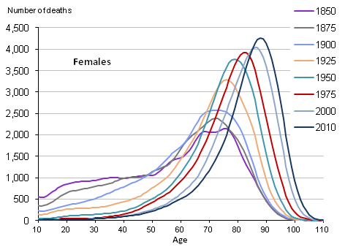
Moving Goal Post
Source: Office for National Statistics, UK

Slide 31
Is it Worthwhile?
As life expectancy increases and non-cancer death decreases, any potential reduction in cancer-deaths becomes proportionately more significant
The benefit of screening would be most pronounced in those who are healthy and have correspondingly longer life expectancy
Dying of breast cancer vs dying with breast cancer

Slide 32
Summary
Patients aged 70 or over present with more advanced disease and worse survival than patients under 70 years of age
While age is an independent predictor of survival in its own right, not having screening is likely to have contributed to the more advanced disease state and poorer survival in the >=70 age group
Patients >= 70 who have screen-detected cancer have better survival when compared to those who have symptomatic, non-screen-detected cancer (with caveats)
The degree of benefit from screening in the >= 70 age group will be largely dependent on the patients’ underlying health status

